Slide 1

Streaming
What is and how?
Mantas.poska@kitm.lt

Slide 2
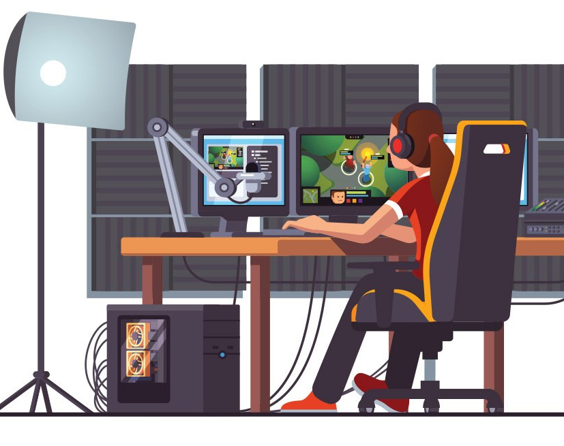
Definition of streaming
Streaming refers to any media content – live or recorded – delivered to computers and mobile devices via the internet and played back in real time.
Podcasts, webcasts, movies, TV shows, music videos and games are ommon forms of streaming content.

Slide 3

How does it work?
Media files are prearranged and transmitted in sequential packets of data so they can be streamed instantly. And unlike traditional download that are stored on device, media files are deleted automatically, once played.
What you need to stream is a reliable and fast internet, streaming app and compatible device.

Slide 4

Live streaming
Is the broadcast of an event over the internet as it heppens.
You can live stream on any compatible smartphone, tablet, TV, computer or gaming console with a fast internet connection.

Slide 5
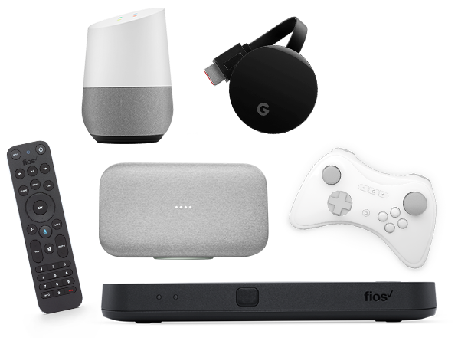
Streaming devices
There are a number of streaming devices available, each with their own unique features. Whether you want a hands-free option, ample internal storage, something affordable and/or 4K accessibility, there’s a streaming device for you.

Slide 6
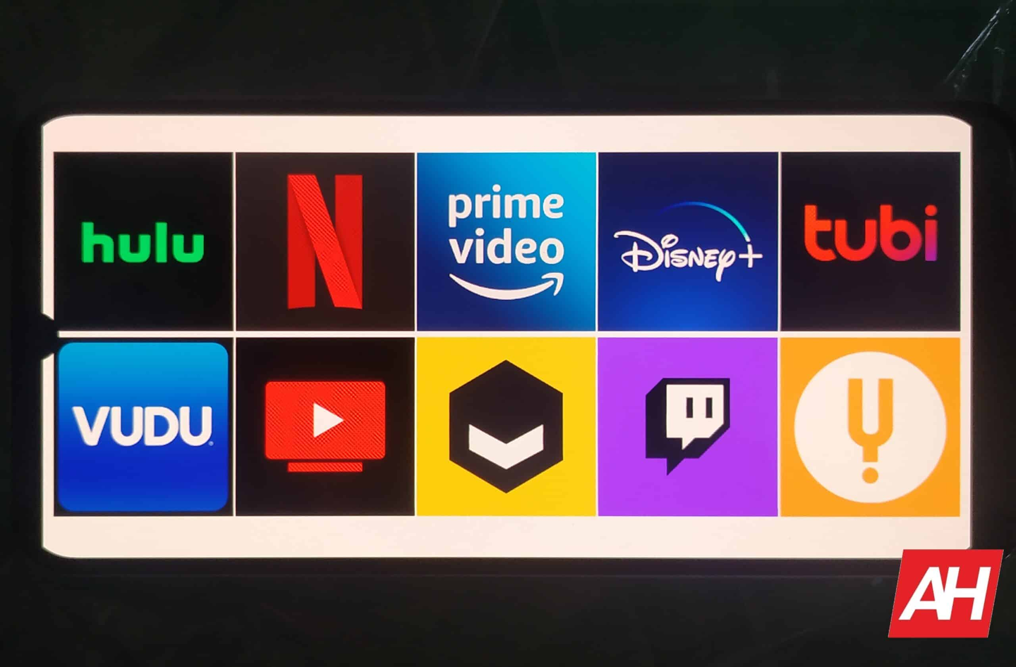
Streaming apps
Now that you know how to stream and the devices you’ll need – what type of content are you going to stream?
Netflix, YouTube TV and several others are still some of the best and most popular streaming services with apps you can access on the go

Slide 7
Streaming apps
Netflix: Best Overall
Disney+: Best for families
Hulu: Best for cord-cutters/ those without a TV Service
HBO Max: Best for newly-released Warner Bros. movies
Peacock: Best for classic movie and TV show fans
Apple TV+: Best for money-savers who like original content

Slide 8
What factors slow down streaming?
On the network side:
Network latency: A variety of factors impact latency, including where the content that users are trying to access is stored.
Network congestion: If too much data is sent through the network, this can degrade streaming performance.
On the user side:
WiFi problems: Restarting the LAN router, or switching to Ethernet instead of WiFi, can help improve streaming performance.
Slowly performing client devices: To play videos takes a good amount of processing power. If the device streaming the video has a lot of other processes running or is just slow in general, streaming performance can be impacted.
Not enough bandwidth: For streaming video, home networks need about 4 Mbps of bandwidth; for high-definition video, they will likely need more.

Slide 9
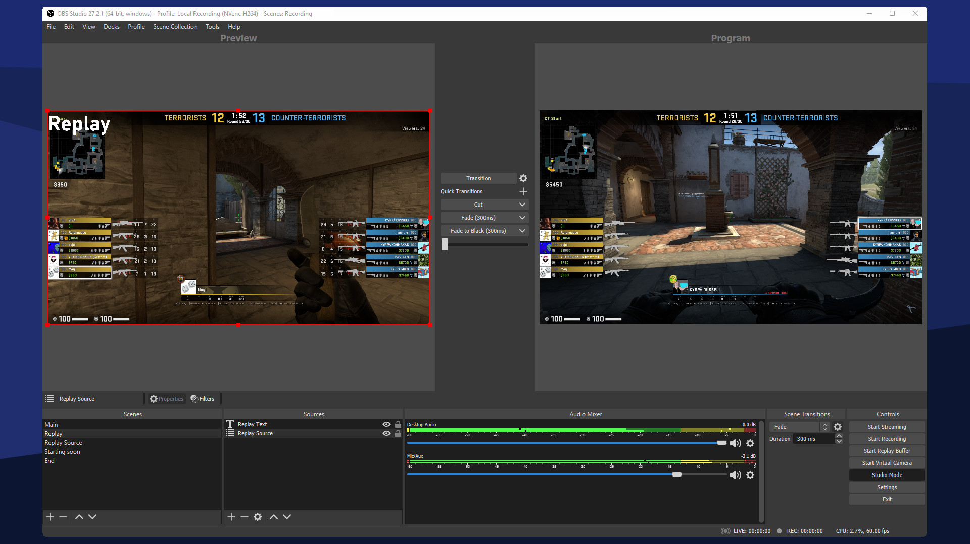

„OBS“ – Open Broadcasting Software

Slide 10
How to Live Stream with OBS
1. Log in or create a free account. 2. Create a new live stream (next slide) or use an existing one. 3. Select your live stream and click 🎥 Live Studio at the top of the screen.

Slide 11
Create a Live Stream Player
Take these steps to create a live stream player that you can then connect to any streaming software (like OBS) or streaming hardware (like EzeCaster Pro).
Create a free account or log in.
Make sure you're on the Media tab ▶️ (default).
If you don't want your live stream to be in the default playlist, hover over the Playlists 🔽 menu and click the plus sign ➕ to add a new playlist. Type a playlist name and click ✅ Confirm.
Click ➕ Add Media at the top of your screen.
Select the Live Stream tab and type a name for your live stream. Select your newly created playlist.
Click the ☑️ Save button to create your player.
Select your live stream in the list and click 🎥 Live Studio at the top of the screen.
Enable Recording and/or Live Chat if you want.

Slide 12
NEXT: Connect your equipment
If you know what to do next, you can simply get your RTMP URL and Stream Key. Go to 🎥 Live Studio > Select Source > RTMP Encoders.
Otherwise, check out the tutorials below to connect your streaming equipment.

Slide 13
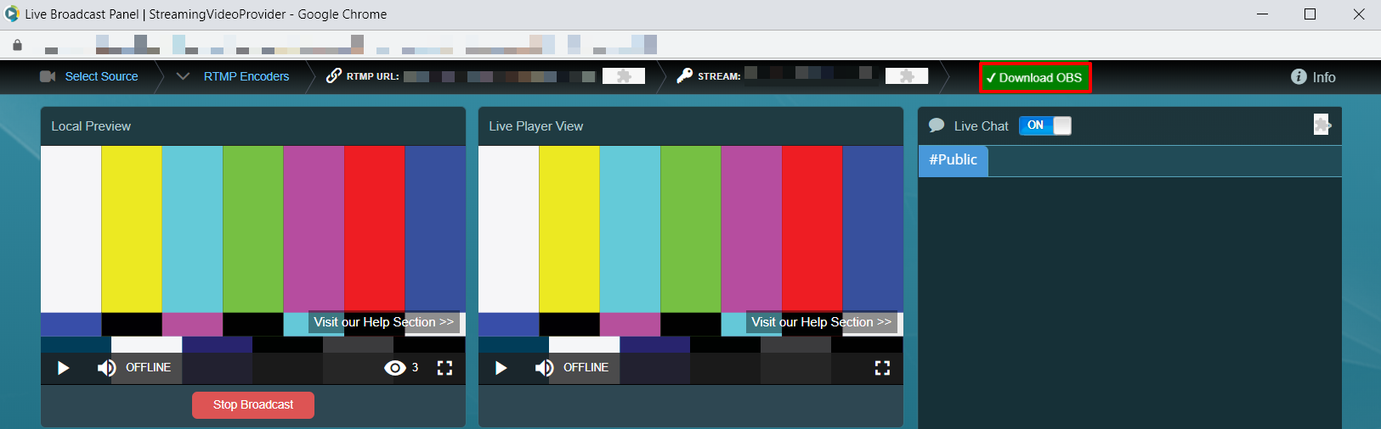
CASE 1: OBS not installed
1. Click the Download OBS button in 🎥 Live Studio. This will download a pre-configured OBS setup file that is ready to work with StreamingVideoProvider.

Slide 14
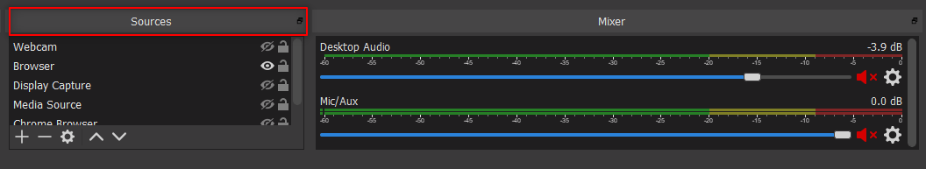
CASE 1: OBS not installed
2. Open the OBS installer and follow the on-screen instructions. 3. Click the ➕ plus button in OBS Sources. See OBS Sources below to learn more about them.

Slide 15
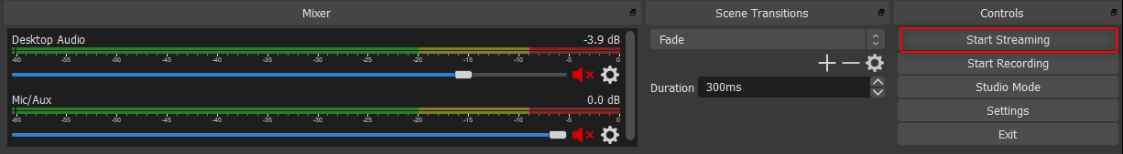
CASE 1: OBS not installed
4. Click Start Streaming in OBS.

Slide 16
CASE 2: OBS already installed
In this case, you will need to pair OBS with StreamingVideoProvider.

Slide 17
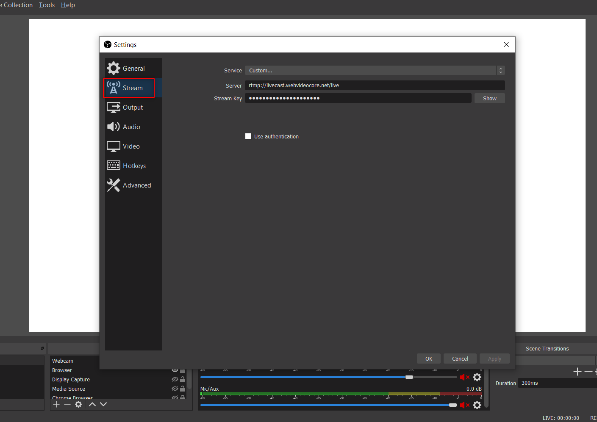
1. Open OBS and click the ➕ plus button in Sources. See OBS Sources below to learn more about them. 2. Go to the StreamingVideoProvider 🎥 Live Studio, click Select Source > RTMP Encoders. 3. Go to OBS Settings (bottom right corner of the screen). 4. Switch to Stream and select Custom from the Service drop down.
4. Copy the RTMP URL and Stream Key from the StreamingVideoProvider 🎥 Live Studio to the OBS Stream Settings. 5. Click OK to save your OBS settings. 6. Your live stream preview should be visible in the StreamingVideoProvider 🎥 Live Studio. Click Start Broadcast.

Slide 18
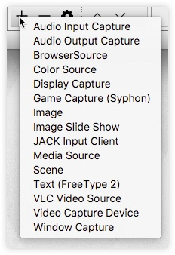
OBS sources
OBS has a large array of sources you can use for streaming. In this tutorial we will be focusing on the top 2 use cases: Streaming cameras via Video Capture Device and streaming your desktop via Window Capture.

Slide 19
Streaming cameras via video capture device
Select Video Capture Device as your source.
In the popup select 🔘 Create New and enter a name for your Camera. Click OK.
Choose your Camera from the Device drop-down menu and change the Presets if you want.
Click OK to save.

Slide 20
Streaming your desktop via window capture
Select Window Capture as your source.
In the popup select 🔘 Create New and enter a name. Click OK.
Choose the Window you would like to stream from the drop down.
Click OK to save.

Slide 21
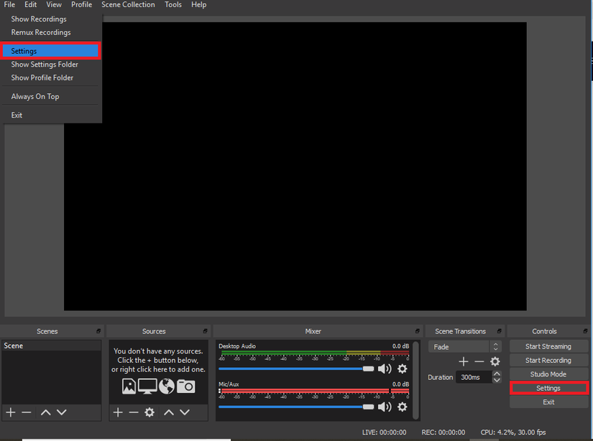
How to change the stream settings in OBS?
Open OBS, and click on ‘Settings’. There are two ways you can do this—either access the ‘Settings’ option through ‘File’ or just click on it from the bottom right corner.

Slide 22
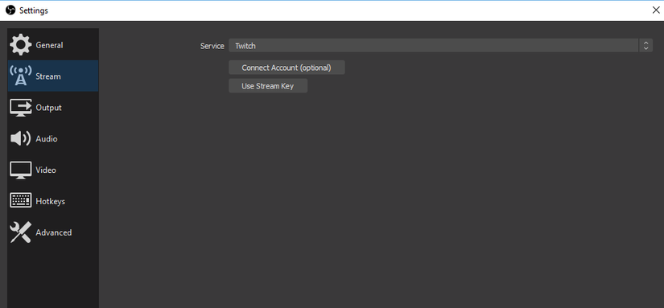
Click on the „Stream“ option in the resulting window.
You can add RTMP streaming keys from different live streaming platforms, such as StreamingVideoProvider

Slide 23
Good Bitrate For OBS
The success of your live stream, especially on social media platforms, is directly influenced by the video quality, and this is where the OBS bitrate comes in. If you get it wrong, you will experience increased buffering or a very low-quality stream.

Slide 24
Test your internet connection speed
For live streaming, an ideal upload speed is of 5Mbps (5000kbps). This is enough to stream at your desired resolution, including 720p at 30 fps and 1080p at 60fps. The minimum upload speed for smooth streaming with good quality is 3Mbps (3000kbps).
You test your upload speed here: https://testmy.net/upload

Slide 25
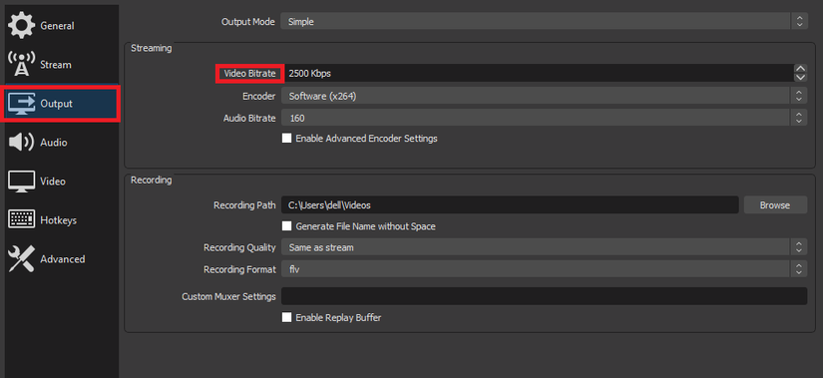
Best OBS Audio Bitrate
Quality | Resolution | Recommended Video Bitrate (kbps)
Low | 270 | 400
Medium | 360 | 800
High | 480 | 1200
High Definition | 720 | 1500
High Definition | 1080 | 4000
Ultra-High Definition | 4K | 8000
The best OBS video bitrate settings depend on your upload speed. By default, the bitrate is set to 2500 which falls somewhere near the middle of the scale. Choosing a video bitrate for your live stream depends on what you want to achieve.

Slide 26
Best OBS Audio Bitrate
Quality | Recommended Audio Bitrate (kbps)
Very Poor | 64
Low | 96
Medium | 128
High | 192
High Quality | 256
High Definition (Highest MP3 quality) | 320
As a rule of thumb, the lower the bitrate, the more compressed the sound will be. This essentially takes away subtle instrument and vocal sounds in the background that may be difficult to hear, but affect the overall quality.

Slide 27
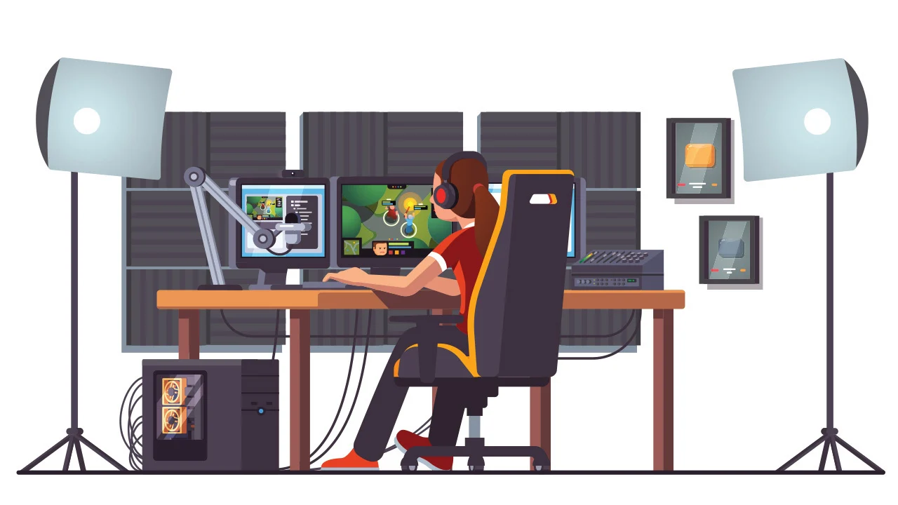
Hope This HELPS :D

