Slide 1


HEY !!!
MANTAS POŠKA

Slide 2

WHO AM I
TEACHER
SOLDIER
GAMER

Slide 3



WHAT I DO
2D
3D
ANIMATION
AND ART IN GENERAL...

Slide 4
WE R GOING TO...
ESPORTS HISTORY
ESPORTS BIGGEST
KITM GAMING NIGHT
GAMING TOURNAMENTS CREATION
VIDEOS

Slide 5
ESPORTS

Slide 6
HISTORY (FIRST ONE)
AT STANFORD UNIVERSITY on OCTOBER 19, 1972.
GAME – “SPACEWAR”(1962)
PRICE – ONE YEAR’S SUB OF ROLLING STONE MAGAZINE

Slide 7
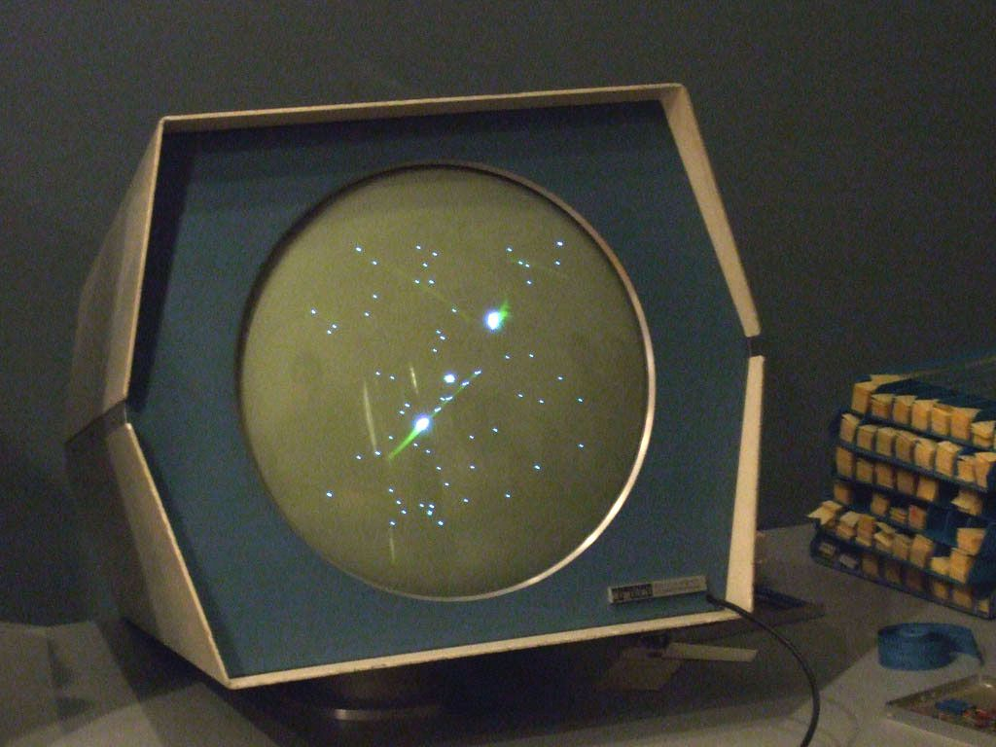

HISTORY (FIRST ONE)

Slide 8
HISTORY (OUT OF SHADOWS)
IN 1980, VIDEO GAME HIT THE MAINSTREAM.
ATARI HELD THE “SPACE INVADERS” CHAMPIONSHIP.
EVENT ATTRACTED OVER 10K PLAYERS.

Slide 9
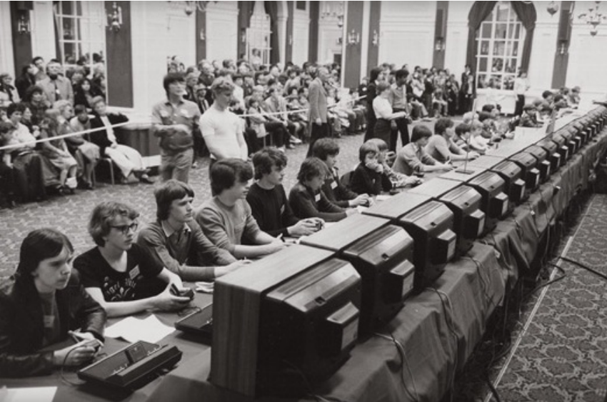
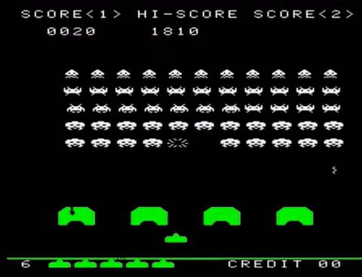
HISTORY (OUT OF SHADOWS)

Slide 10
HISTORY (NINTENDO)
TOOK THE CONTROLS, GRAPHICS, GAMEPLAY AND ACCESSIBILITY OF VG TO A NEW LEVEL.
GEGA GENESIS CAME OUT IR 1989 FOR A SHORT TIME.
SNES CHAMP. IN 1994.

Slide 11
HISTORY (PC GAMING AND INTERNET)
MADE IT POSSIBLE TO FACE EACH OTHER ACROSS THE WORLD.
SOME OF FIRST ESPORTS EVENTS LEAGUES WERE IN LATE 1990’s.
CYBERATHLETE PROF. LEAGUE, PROF. GAMERS LEAGUE AND QUAKECON.

Slide 12
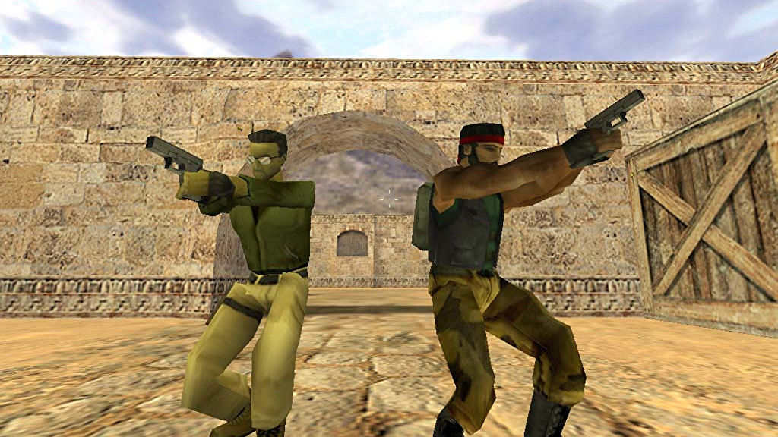
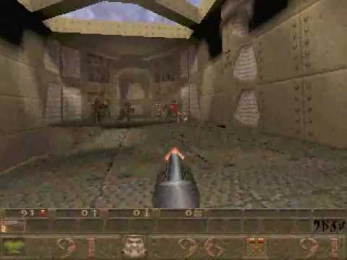
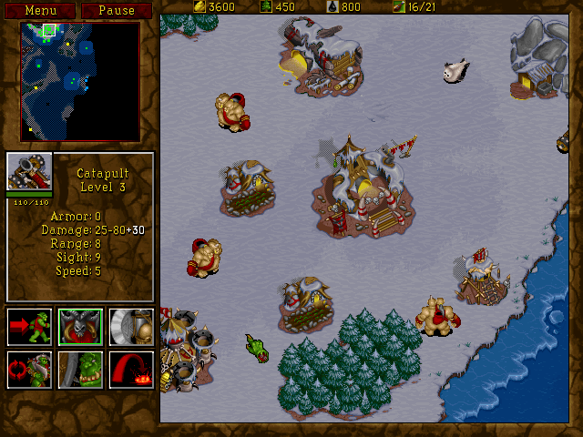
HISTORY (PC GAMING AND INTERNET)
GAME LIKE QUAKE, CS, WARCRAFT WERE FEATURED IN EVENTS

Slide 13
HISTORY (EXPLODE INTO THE 21st CENTURY)
INTERNET CAFES STARTED POPPING UP AROUND THE WORLD.
2000 – 2010 THERE WERE ABOUT 40 TOURNAMENTS HELD WORLDWIDE.
PLAYERS COMPETED FOR A PRICZES UP TO 1MILLION DOLARS.

Slide 14
HISTORY (TWITCH)
THE WORLD NEVER HAD ACCESS TO THE EXCITEMENT OF COMPETITIVE GAMING AS A SPECTATOR SPORT
BUT THEN, TWITCH WAS FOUNDED…

Slide 15
HISTORY (TWITCH)
HITTING THE SCENE IN 2011, TWITCH GAVE ESPORTS AN UNTHINKABLE HEIGHTS.
GAMES LIKE LOL AND DOTA2 BECAME POPULAR AS SPECTATOR SPORTS, BRINGING IN MILLIONS.

Slide 16
THE BIGGEST

Slide 17
BIGGEST
(ESPORTS GAMES BY PRICE MONEY IN 2021)
DOTA 2 – $47.2 MILLION
CS:GO - $21 MILLION
PUBG: BATTLEGROUNDS - $16 MILLION
PUBG: MOBILE - $14.5 MILLION
ARENA OF VALOR - $12.3 MILLION
FORTNITE - $9.5 MILLION
LOL - $7.3 MILLION

Slide 18
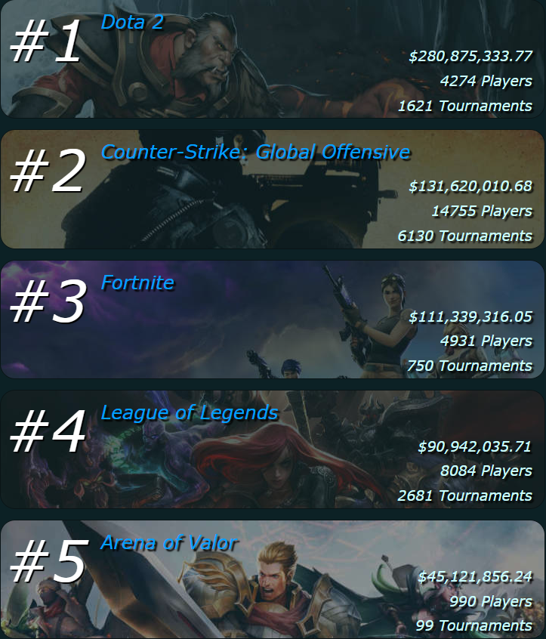
TOP GAMES (AWARDING PRIZE MONEY)

Slide 19
TOP GAMES (BY HOURS WATCED IN 2021)
LOL – 664.1 MILL
CS:GO – 410.8 MILL
MOBILE LEGENDS: BANG BANG - 387.2 MILL
DOTA 2 – 347.6 MILL
PUBG MOBILE – 216.7 MILL

Slide 20


Slide 21
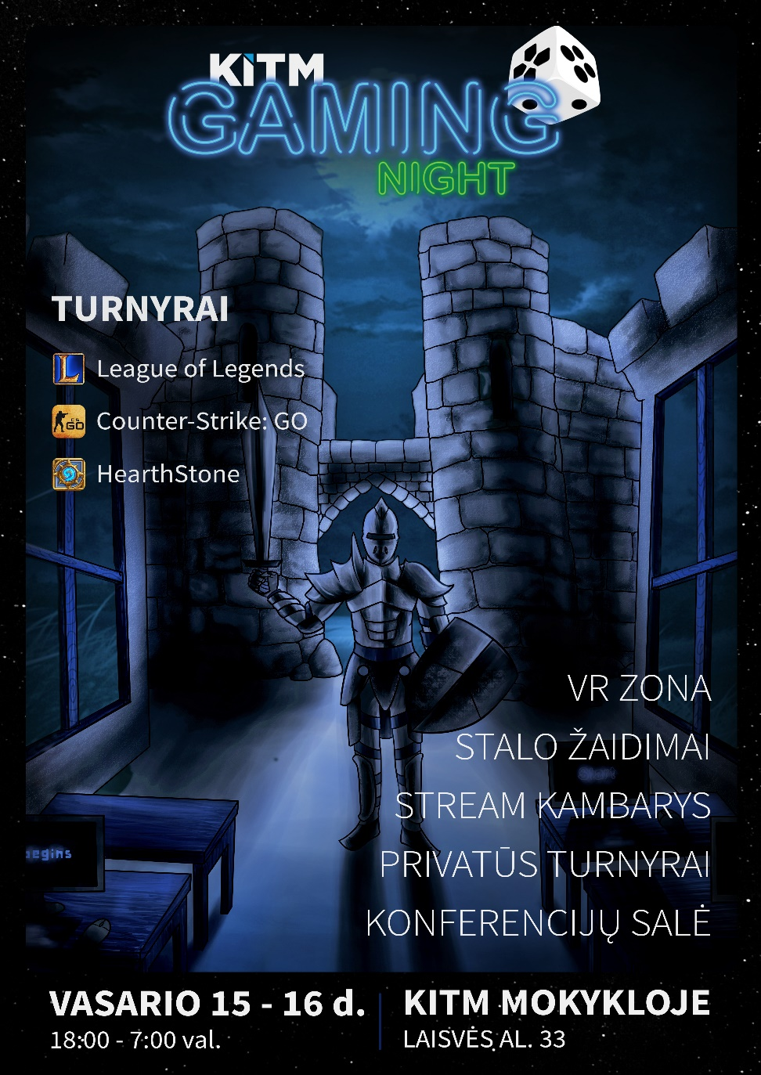
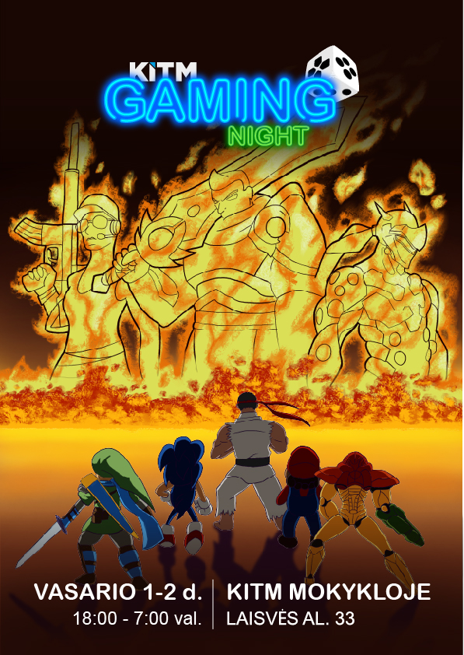


Slide 22
TOURNAMENTS

Slide 23
DO’S AND DONT’S
DO: UNDERSTAND THE GAME YOU’RE HOSTING
DON’T: ASSUME EVERY CONTEST PLAYS THE SAME
DO: LOOK TO HIRE TOP ANNOUNCERS
DON’T: RUN IT WITHOUT PARTNERS

Slide 24
DO’S AND DONT’S
DO: TALK TO THE GAME DEVELOPER
DON’T: ATTEMPT TO GO CRAZY AS HELL WITH YOUR CREATIVITY

Slide 25
TIPS (FOR RUNNING AN ONLINE TOURNAMENT)
1. SEE IF YOUR GAME HAS THE NECESSARY TOOLS

Slide 26
TIPS (FOR RUNNING AN ONLINE TOURNAMENT)
2. DECIDE THE RULES

Slide 27
TIPS (FOR RUNNING AN ONLINE TOURNAMENT)
3. DECIDE HOW YOU’LL ACTUALLY RUN IT
SMASH.GG
CHALLONGE
TOORNAMENT

Slide 28
TIPS (FOR RUNNING AN ONLINE TOURNAMENT)
4. DECIDE IF YOU’RE GOING TO STREAM

Slide 29
TIPS (FOR RUNNING AN ONLINE TOURNAMENT)
5. PROMOTE IT !!!

Slide 30
TIPS (FOR RUNNING AN ONLINE TOURNAMENT)
6. RUN IT, THEN DECIDE WHETHER OR NOT YOU EVER WANT TO GO THROUGH THAT AGAIN

Slide 31
VIDEOS

Slide 32
„DreamHack“ sports Games studio tour
Behind the stream (part 1)
VIDEOS
Behind the stream (part 2)
Behind the stream (part 3)
Control room view

